Slide 1
Relational Model Concepts in DBMS
Attribute: Each column in a Table. Attributes are the properties which define a relation. e.g., Student_Rollno, NAME,etc.
Tables – In the Relational model the, relations are saved in the table format. It is stored along with its entities. A table has two properties rows and columns. Rows represent records and columns represent attributes.
Tuple – It is nothing but a single row of a table, which contains a single record.
Relation Schema: A relation schema represents the name of the relation with its attributes.
Degree: The total number of attributes which in the relation is called the degree of the relation.
Cardinality: Total number of rows present in the Table.
Column: The column represents the set of values for a specific attribute.
Relation instance – Relation instance is a finite set of tuples in the RDBMS system. Relation instances never have duplicate tuples.
Relation key : KEYS in DBMS is an attribute or set of attributes which helps you to identify a row(tuple) in a relation(table).

Slide 2
Relation schema defines the design and structure of the relation like it consists of the relation name, set of attributes/field names/column names. every attribute would have an associated domain.

Slide 3
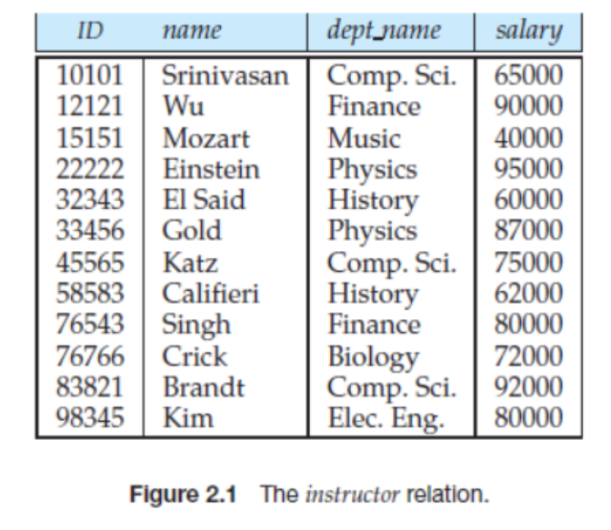

Slide 4
Relational Database Schema
A set of relation schemas {R₁, R₂,……,R_{m}} together with a set of integrity constraints in the database constitutes relational database schema. A relational database schema, say S, is represented as S = {R₁, R₂,……, R_{m}).
For example, the relational database schema for Online Book database is a set of relation schemas, namely, BOOK, PUBLISHER, AUTHOR, AUTHOR_BOOK and REVIEW, which is shown in below

Slide 5
department (deptId, name, hod, phone)
course (coursId, ename, credits, deptNo)
professor (empId, name, sex, startYear, deptNo, phone)

Slide 6
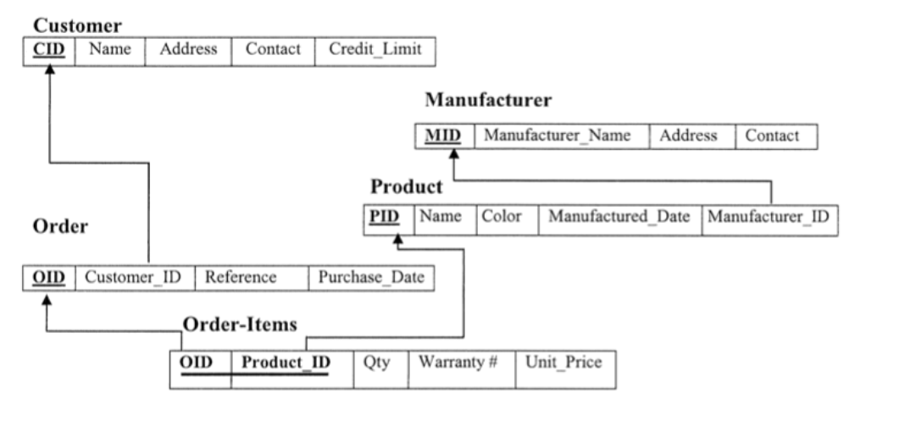

Slide 7
Relational Algebra
RELATIONAL ALGEBRA is a widely used procedural query language. It collects instances of relations as input and gives occurrences of relations as output. It uses various operations to perform this action. SQL Relational algebra query operations are performed recursively on a relation. The output of these operations is a new relation, which might be formed from one or more input relations.

Slide 8
Relation operations
σ _{sales > 50000} (Customers)
SELECT (symbol: σ)
The SELECT operation is used for selecting a subset of the tuples according to a given selection condition. Sigma(σ)Symbol denotes it. It is used as an expression to choose tuples which meet the selection condition.
σ topic = "Database" (Tutorials)
σ topic = "Database" and author = "guru99"( Tutorials)

Slide 9
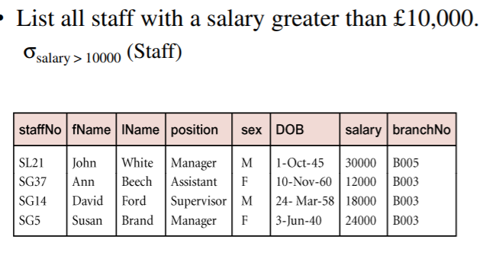

Slide 10
Projection(π)
The projection eliminates all attributes of the input relation but those mentioned in the projection list. The projection method defines a relation that contains a vertical subset of Relation.
Π CustomerName, Status (Customers)

Slide 11
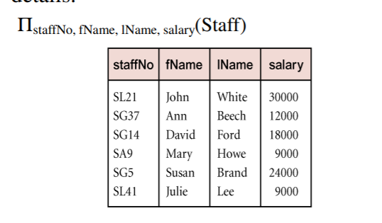

Slide 12
π name, address (σ age>18 (People))

Slide 13
Union operation (υ)
UNION is symbolized by ∪ symbol. It includes all tuples that are in tables A or in B. It also eliminates duplicate tuples. So, set A UNION set B would be expressed as:

Slide 14
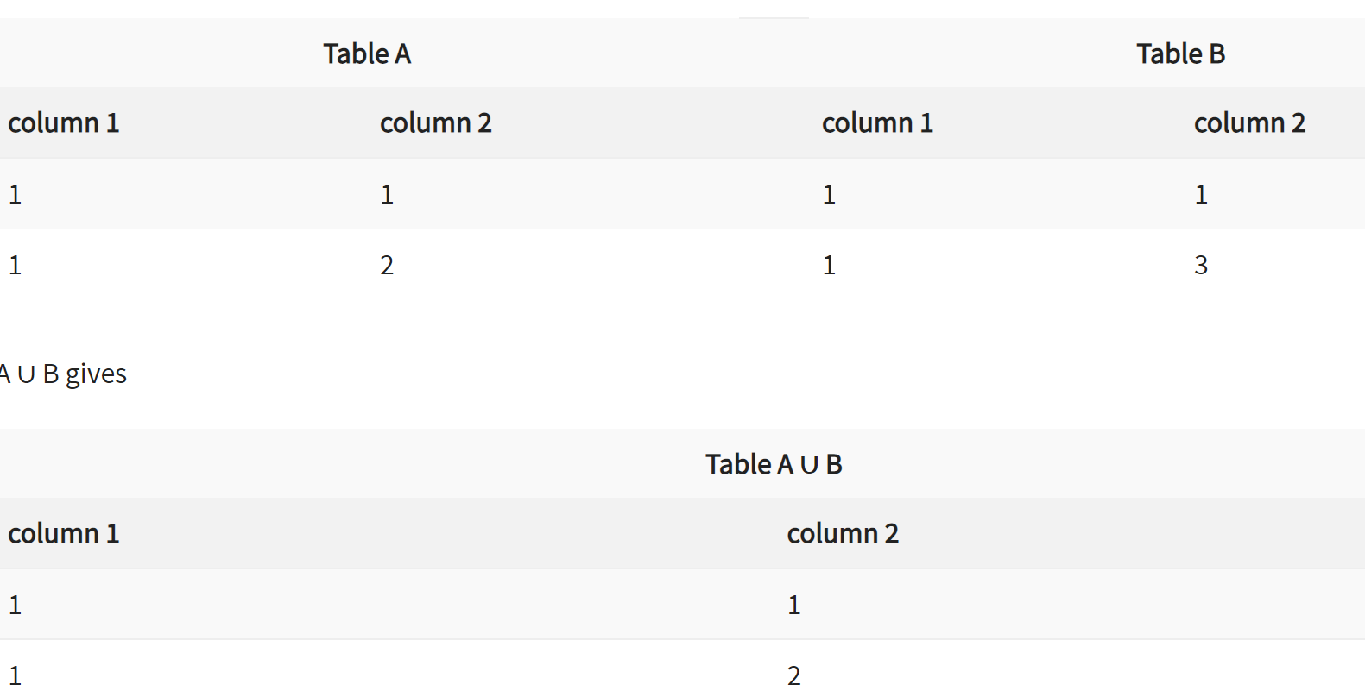

Slide 15
Set Difference (-)
– Symbol denotes it. The result of A – B, is a relation which includes all tuples that are in A but not in B.
The attribute name of A has to match with the attribute name in B.
The two-operand relations A and B should be either compatible or Union compatible.
It should be defined relation consisting of the tuples that are in relation A, but not in B.

Slide 16
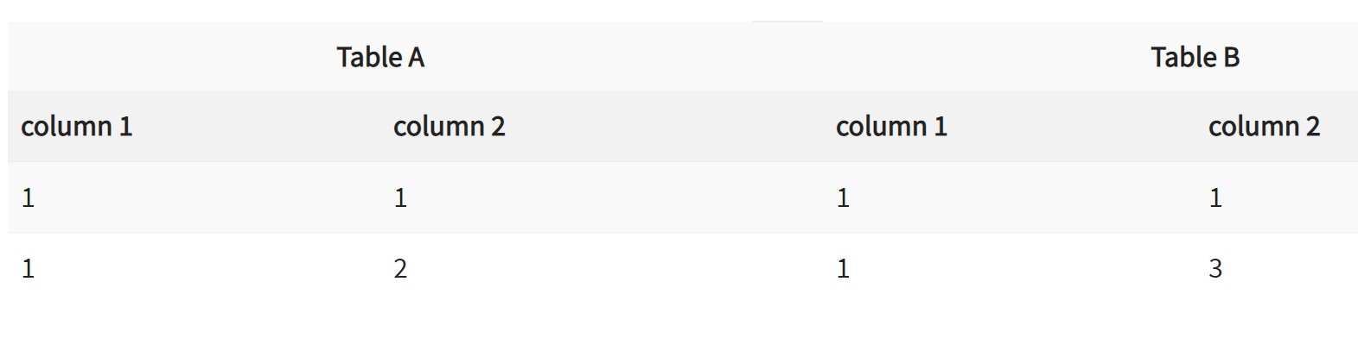
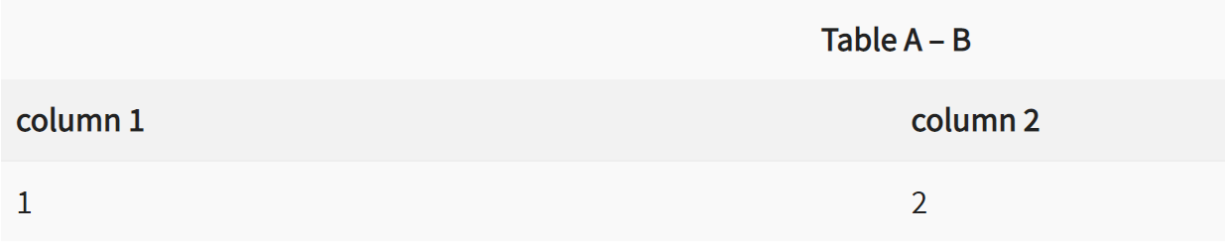

Slide 17
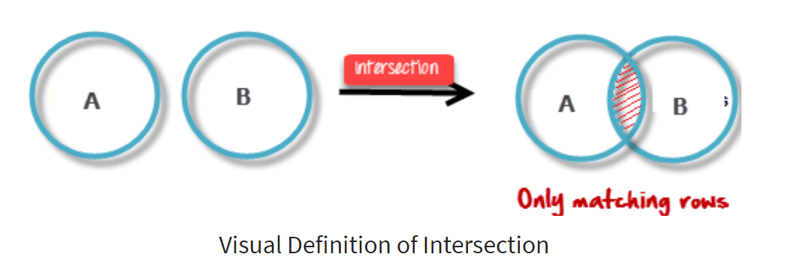
Intersection
An intersection is defined by the symbol ∩
A ∩ B
Defines a relation consisting of a set of all tuple that are in both A and B. However, A and B must be union-compatible.

Slide 18
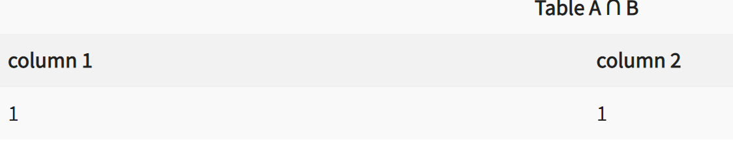

Slide 19
Cartesian Product
Cartesian Product in DBMS is an operation used to merge columns from two relations. Generally, a cartesian product is never a meaningful operation when it performs alone. However, it becomes meaningful when it is followed by other operations. It is also called Cross Product or Cross Join.

Slide 20
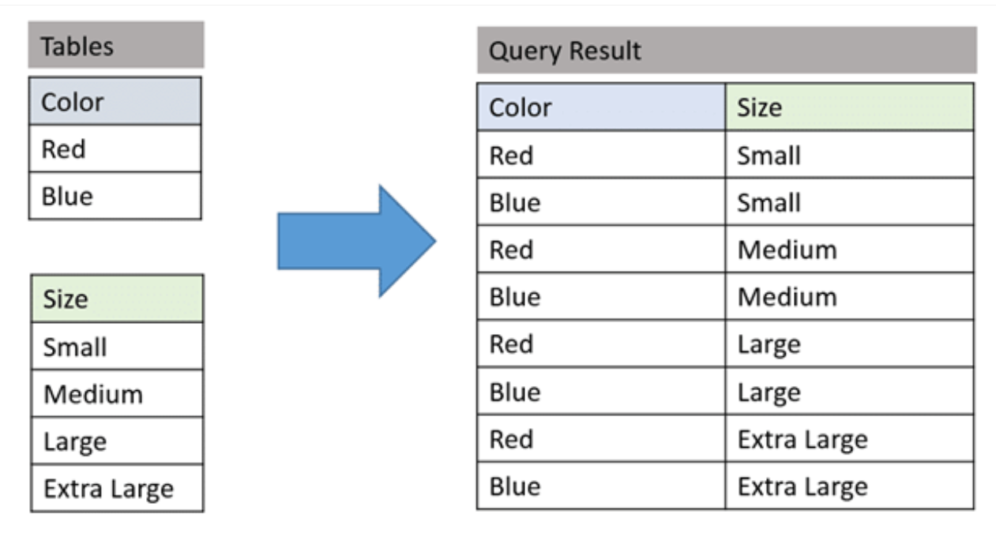

Slide 21
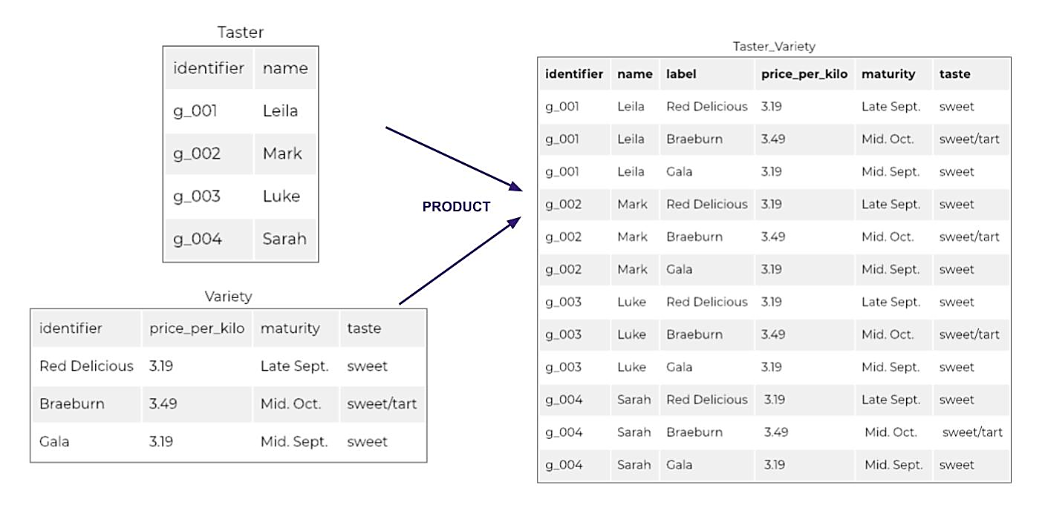

Slide 22
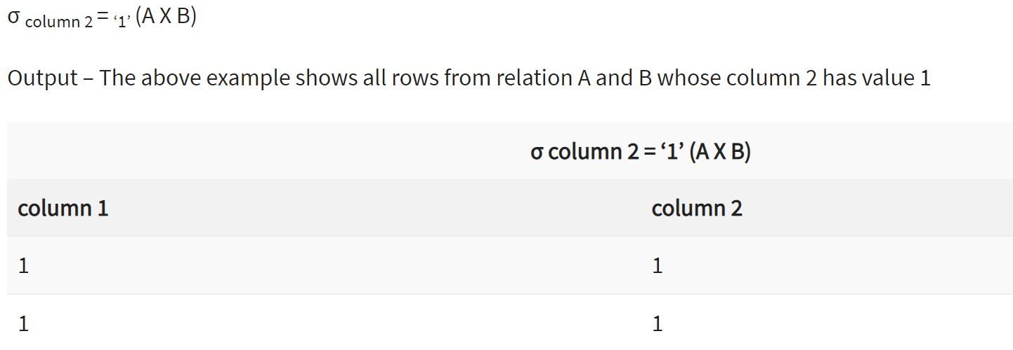

Slide 23
Join Operations
Join operation is essentially a cartesian product followed by a selection criterion.
Join operation denoted by ⋈.
JOIN operation also allows joining variously related tuples from different relations.

Slide 24
Types of JOIN:
Various forms of join operation are:
Inner Joins:
Theta join
EQUI join
Natural join
Outer join:
Left Outer Join
Right Outer Join
Full Outer Join

Slide 25
Theta Join:
The general case of JOIN operation is called a Theta join. It is denoted by symbol θ
Example
A ⋈θ B
Theta join can use any conditions in the selection criteria.
For example:
A ⋈ A.column 2 > B.column 2 (B)

Slide 26
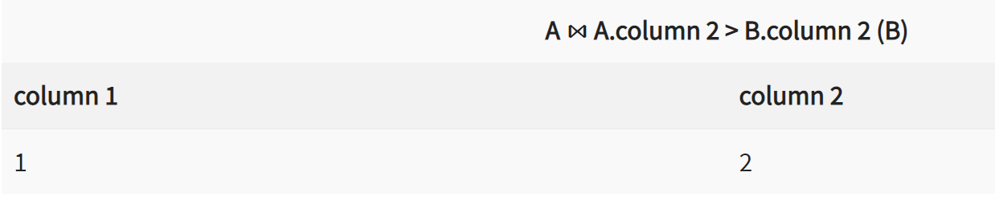

Slide 27
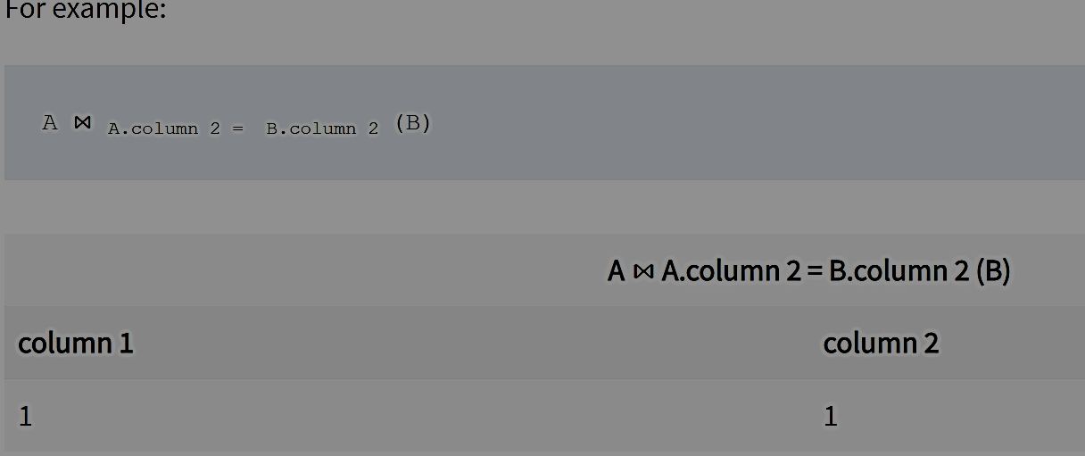
EQUI join:
When a theta join uses only equivalence condition, it becomes a equi join.

Slide 28
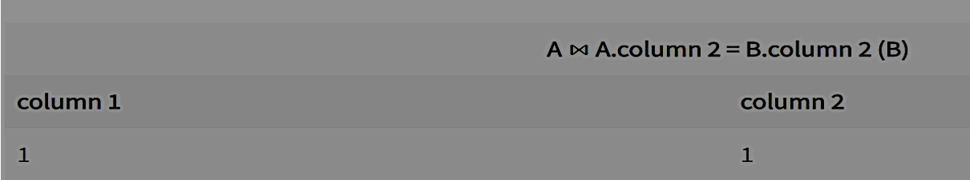

Slide 29
NATURAL JOIN (⋈)
Natural join can only be performed if there is a common attribute (column) between the relations. The name and type of the attribute must be same.

Slide 30
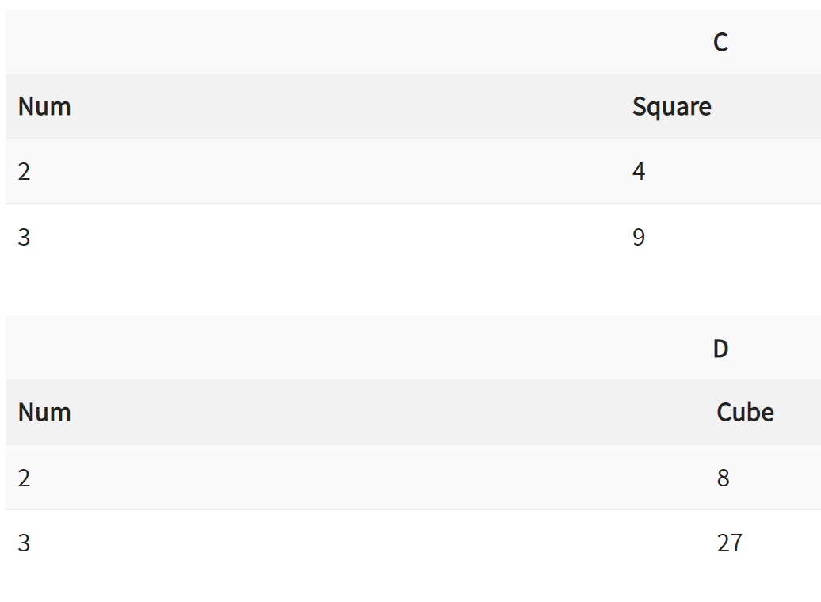
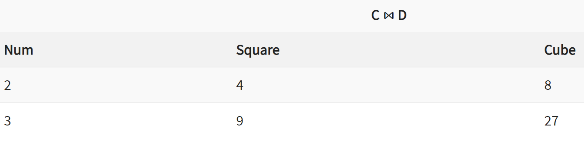

Slide 31
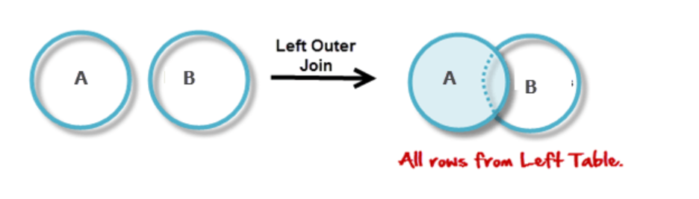
Outer Join
Left Outer Join(A⟕ B)
In the left outer join, operation allows keeping all tuple in the left relation. However, if there is no matching tuple is found in right relation, then the attributes of right relation in the join result are filled with null values.

Slide 32
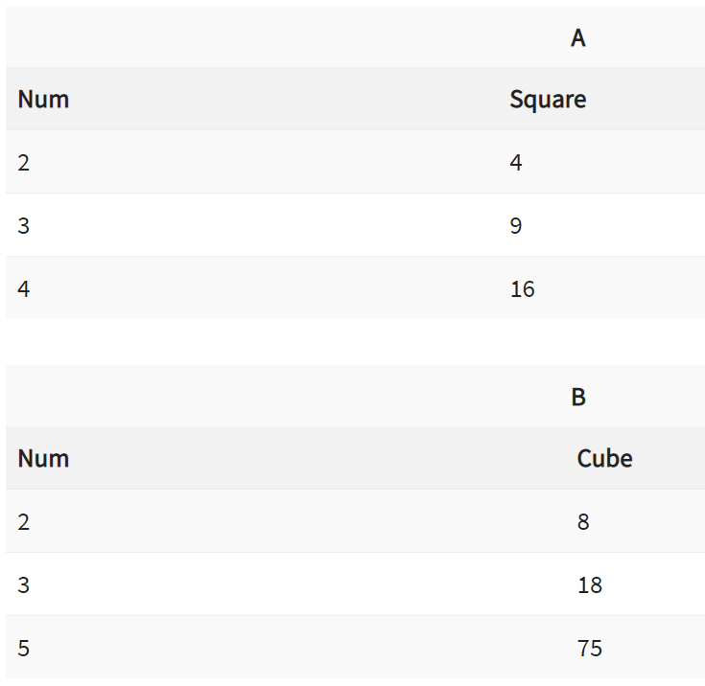
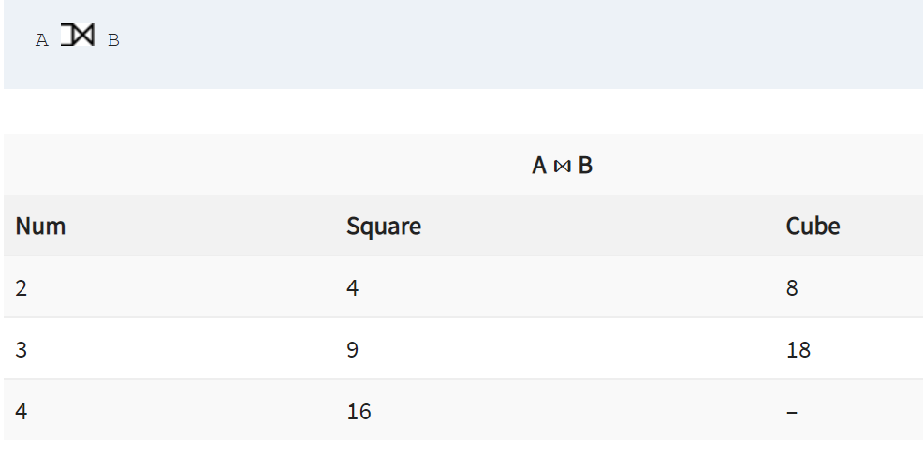

Slide 33
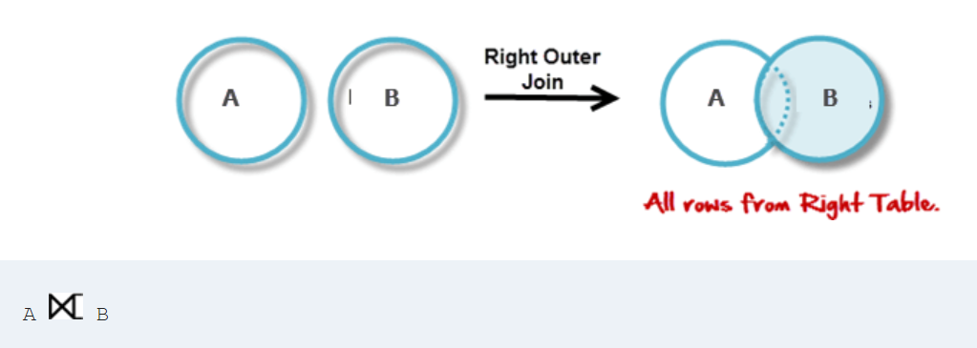
Right Outer Join: ( A ⟖B )
In the right outer join, operation allows keeping all tuple in the right relation. However, if there is no matching tuple is found in the left relation, then the attributes of the left relation in the join result are filled with null values.

Slide 34
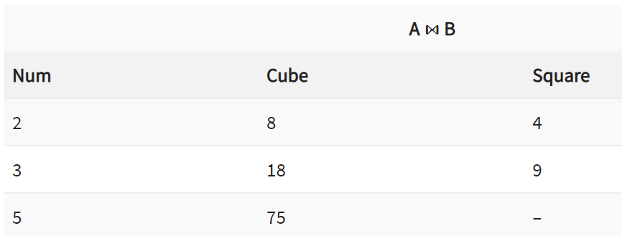

Slide 35
Full outer join
In a full outer join, all tuples from both relations are included in the result, irrespective of the matching condition.

Slide 36
